Slide 1
Google Earth Engine Hazard Assets Description
Layer Name | Description
adm0 | UNICEF/Georepo administrative level 0 shapefile
Drgt_VCI_Freq | VCI (Vegetation Condition Index) Annual drought Frequency (2000 - 2022)
Drgt_TCI_Freq | TCI (Temperature Condition Index) Annual drought Frequency (2000 - 2022)
Drgt_SPIA_Freq | SPI (Standardized Precipitation Index) Annual drought frequency (2014 – 2023)
Drgt_SPIQ_Freq | SPI (Standardized Precipitation Index) Quarterly drought frequency (2014 – 2023)
Drgt_SPIQ_Trend | SPI (Standardized Precipitation Index) Quarterly Trend (2014 – 2023)
Deg_VCI_Trend | Annual VCI (Vegetation Condition Index) Trend
HW_Frequency | Heatwave Frequency (2021 – 2023 with reference to 2001 – 2020 climatological reference period)
HW_Severity | Heatwave Severity (2021 – 2023 with reference to 2001 – 2020 climatological reference period)
HW_Duration | Heatwave Duration (2021 – 2023 with reference to 2001 – 2020 climatological reference period)
HW_TX35 | Mean annual days with temperature > 35°C (2021 – 2023 )
HW_TX31 | Mean annual days with temperature > 31°C (2021 – 2023 )
CW_Frequency | Coldwave Frequency (2021 – 2023 with reference to 2001 – 2020 climatological reference period)
CW_Severity | Coldwave Severity (2021 – 2023 with reference to 2001 – 2020 climatological reference period)
CW_Duration | Coldwave Duration (2021 – 2023 with reference to 2001 – 2020 climatological reference period)
CW_TXMinus15 | Mean annual days with temperature <-15°C (2021 – 2023)
Fld_SPIA_Freq | SPI (Standardized Precipitation Index) Annual Flood frequency (2014 – 2023)
Fld_SPIQ_Freq | SPI (Standardized Precipitation Index) Annual Quarterly frequency (2014 – 2023)
CountryList | Table of Country names, iso3 and UNICEF regions
WFire_Freq | Wildfire Frequency (2001 – 2023)
WFire_Int | Wildfire Intensity (2001 – 2023)
WFire_FWI_LS | FWI - Fire Weather Index (2001 – 2023)
All layers available as assets are preloaded. Users can change the name of their layers of interest in the main Google Earth Engine script editor.

Slide 2
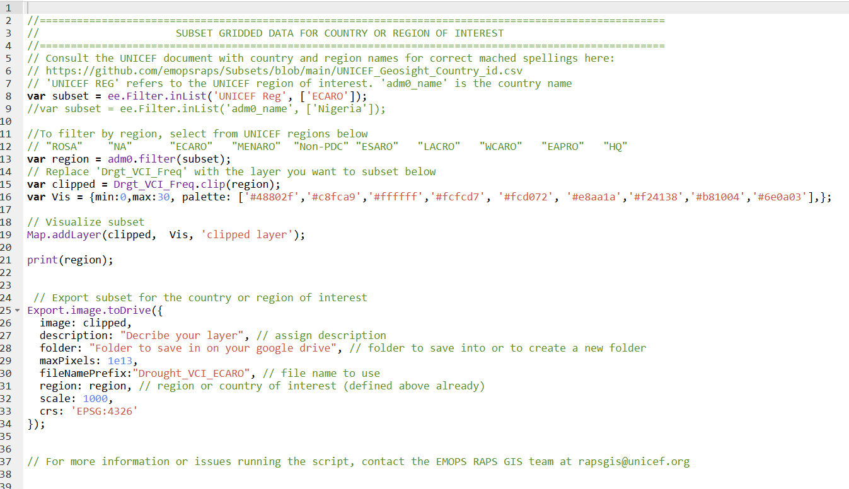
Editing the Google Earth Engine Script
Define region of interest in square brackets and quotes. To comment out the region subset line and use country name, remove // at the start of line 9 and add it to start of line 8. Country name must be based on Country name (adm0_name) list provided here: https://github.com/emopsraps/Subsets/blob/main/UNICEF_Geosight_Country_id.csv
Do NOT change. Pre-defined variable
Define layer name to subset. The name MUST be based on the Layer Description list
Define layer to be subset. The name MUST be based on the Layer description list
Define EPPSG of coordinate system for exporting subset
Define scale for export in kilometres
Do NOT change.
Pre-defined variable
Define filename in quote. Use underscore (_) instead of spaces to separate words
Define folder name in quote. Use underscore (_) instead of spaces to separate words
Layer short description in quote. Shorten as much as possible
Do NOT change. Pre-defined variable
https://github.com/emopsraps/Subsets/blob/main/UNICEF_Geosight_Country_id.csv

